Slide 1
PEGA Decisioning Essentials

Slide 2
Agenda – Session 9
Datasets

Slide 3
Datasets
Data sets define collections of records, allowing you to set up instances that make use of data abstraction to represent data stored in different sources and formats.
Besides from data sets you define in your application, there are two default data sets:
pxInteractionHistory
Class: Data-pxStrategyResult
This data set is represents Interaction History results. It is used to write the captured response information to the Interaction History data store through activities or data flows.
pxAdaptiveAnalytics
Class: Data-pxStrategyResult
This data set represents adaptive inputs. It is used to update the adaptive data store through activities or data flows.

Slide 4
Database tables - Dataset
Data sets are referenced in data flows and, through the DataSet-Execute method, in activities.
Create a dataset that represents a database table easily inorder to perform browse, save or delete operations
PREDICTION STUDIO > DATA > DATA SET
Now select the class which has the data type with existing records.
Save the dataset and run the data set standalone
Then u can perform the below operations or use this dataset
Inside a data flow.

Slide 5
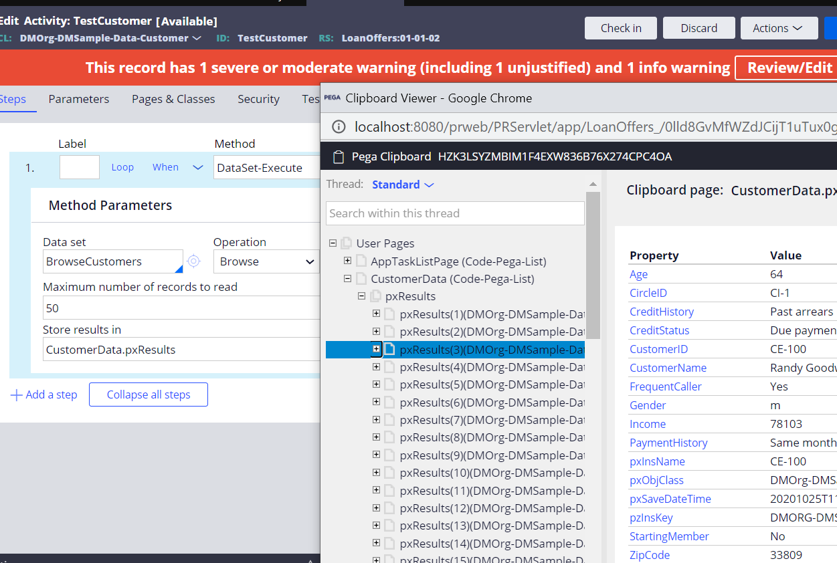
Execute a dataset from activity to get the results on clipboard

Slide 6
Visual Business Director
Data sources are Visual Business Director data sets in this application. The Actuals data source contains Interaction History records. Browse data sources using Visual Business Director. Configure the start date of monitoring data by expanding the data source entry.
Visual Business director displays the results of customer responses in a realtime view using a 3d VIEW.
Navigate to Configure > Decisioning > Monitoring > Visual Business Director
Now click on the ACTUALS.
The actuals displays the interaction history records, i.e the actual data generated by customers.
Data sources for the visual business director are the data sets itself.

Slide 7
VBD
Inorder to display the data sources in the visual business director.
We just need to create a data set of type VISUAL BUSINESS DIRECTOR in the application
This is just like a summary view report definition where need to include an aggregate column.
Select a numeric column and select aggregate function.
Then the VBD Will be enabled.
The visual business director by default sets the GROUP as Xaxis and CHANNEL in the YAXIS.
Inorder to edit them double click on the axis and edit.
This data set stores data using Visual Business Director, which leverages the real-time data grid. To manage the memory footprint, define the time granularity and the dimension levels to aggregate.

Slide 8
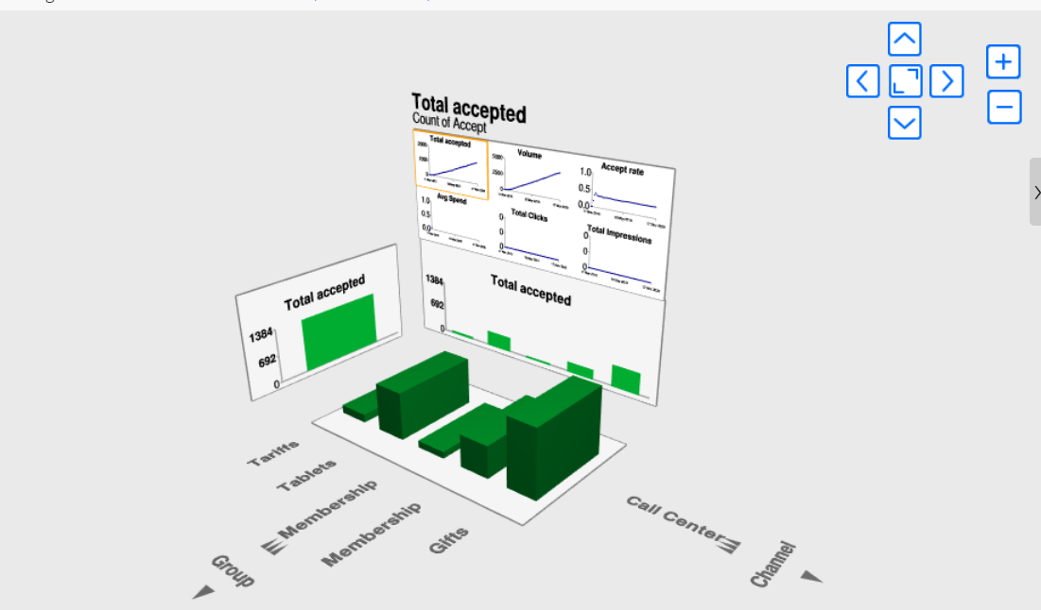

Slide 9
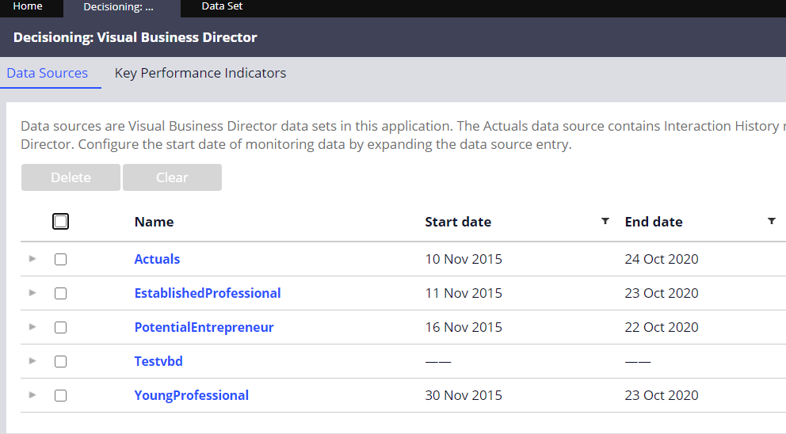
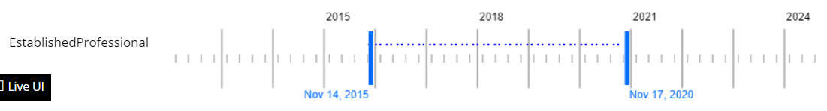
VBD Results
We can also edit the time range of the VBD Data by dragging and changing the specific time range.
Drag and move the curser to change time range.
See the newly created VBD Data set is now displayed under the visual business director
Deleting this data set will remove this from the VBD Landing page.

Slide 10
Questions!

